Slide 1
Macros

Slide 2
Group Members:
Isaac Kiplel
Rodney Bakari
Fiona Ochieng
Samuel Mulwa
Austin Waigwe

Slide 3
What is a Macro?
It is a replacement facility that provides a simple mechanism to name a frequently used sequence of instructions
This requires only one line of code for each use instead of repeatedly typing in the instruction sequence each time.
Writing a macro is another way of ensuring modular programming(subdividing a computer program into separate sub-programs) in assembly language.

Slide 4
Advantages of using Macros
Less code has to be written
Code is short, simple and easy to understand
Errors can easily be identified
A single macro can be developed for reuse, eliminating repetitive coding

Slide 5
Macro definition in an Assembly Language Code
Macros must be defined before they are used
They are placed in the source file before the data and the code sections
The macro is used in the text section

Slide 6
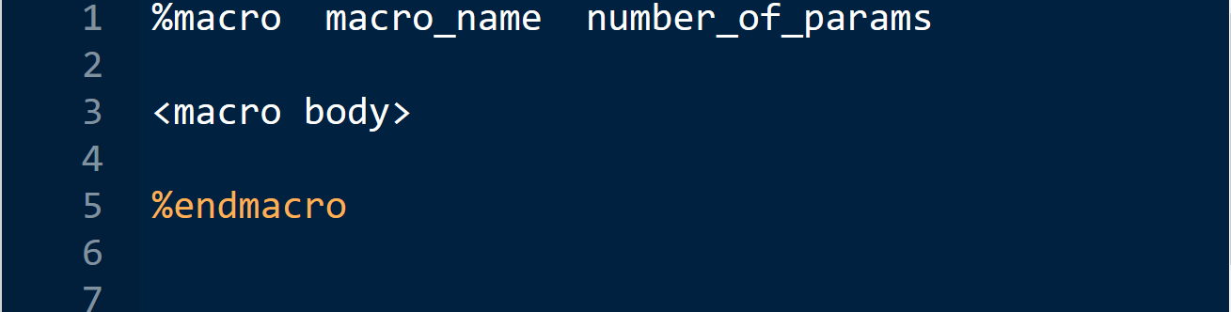
The Syntax for macro definition
Where:
macro_name - specifies the name of the macro
number_of_params - specifies the number parameters

Slide 7
Types of Macros
There are two key types of macros:
Single-Line Macros
Multi-Line Macros

Slide 8

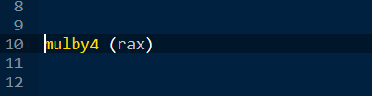
Single-Line Macros
Defined using the %define directive
Example:
Use the macro by entering:
This will multiply the contents of the rax register by 4 (via shifting 2 bits)

Slide 9
Multi-Line Macros
Multi-Line Macros include a varying number of lines(including one)
Arguments can be referenced within the macro by %<number>, with %1 being the first argument, and %2 the second argument, and so forth
In order to use labels, the labels within the macro must be prefixing the label name with a %%.
(Our Main Focus)

Slide 10
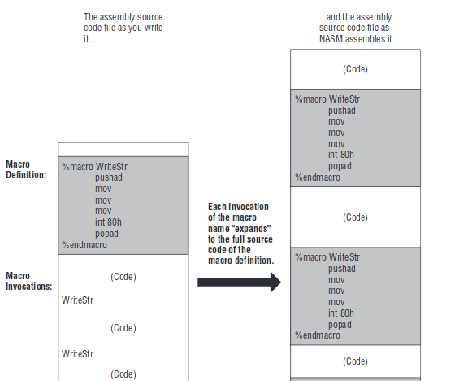

Slide 11
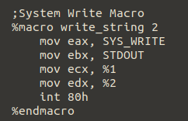
Examples
Assembly code to find sum of 2 numbers.
System Write macro example

Slide 12
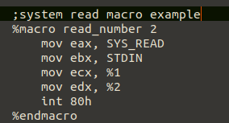
Examples
System read macro example

Slide 13
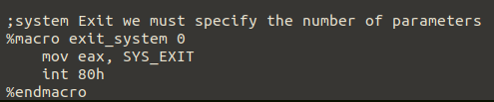
Examples
System exit macro example

Slide 14
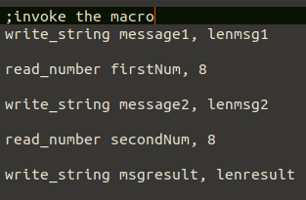
Examples
Invocation of macros

Slide 15
Quiz Question 1
Where is the macro definition placed in the assembly language source file?
Answer
Before using a macro, it must be defined. Macro definitions should be placed in the source file before the data and code sections

Slide 16
Quiz Question 2
When a macro is invoked, how many times is the code placed in the code segment?
Answer
Each invocation of the macro name "expands" to the full source code of the macro definition.
So, Just once

Slide 17
Quiz Question 3
What is the disadvantage of using Macros?
Answer:
Macros typically use more memory.

Slide 18
Thank you

